Slide 1
Luke 1: 67-79 (GNT)
67 John's father Zechariah was filled with the Holy Spirit, and he spoke God's message:
68 “Let us praise the Lord, the God of Israel! He has come to the help of his people and has set them free. 69 He has provided for us a mighty Savior, a descendant of his servant David. 70 He promised through his holy prophets long ago 71 that he would save us from our enemies, from the power of all those who hate us. 72 He said he would show mercy to our ancestors and remember his sacred covenant.

Slide 2
Luke 1: 67-79 (GNT)
73-74 With a solemn oath to our ancestor Abraham he promised to rescue us from our enemies and allow us to serve him without fear, 75so that we might be holy and righteous before him all the days of our life. 76 “You, my child, will be called a prophet of the Most High God. You will go ahead of the Lord to prepare his road for him, 77 to tell his people that they will be saved by having their sins forgiven. 78 Our God is merciful and tender. He will cause the bright dawn of salvation to rise on us 79 and to shine from heaven on all those who live in the dark shadow of death, to guide our steps into the path of peace.”

Slide 3
Anthems of Christmas

Slide 4
Anthems of Christmas
Expectation – Elisa Dickenson
Preparation – Denise Hyland
Proclamation – Greg Mellow
Revelation – Kay Brown
Christmas Day – Philip Adams

Slide 5
Anthems of Christmas
Preparation – Ready for Jesus
Luke 1:67-80

Slide 6
⁶⁸ Praise be to the Lord,
the God of Israel, because he has
come to his people
and redeemed them
⁶⁹ He has provided for us a mighty Savior, a descendant of his servant David.

Slide 7
⁷⁰ He promised through
his holy prophets long ago
⁷¹ that he would save us from our enemies, from the power of all those who hate us.

Slide 8
⁷² He said he would show mercy to our ancestors and remember his sacred covenant.
⁷³⁻⁷⁴ With a solemn oath to our ancestor Abraham he promised to rescue us from our enemies
and allow us to serve him without fear,
⁷⁵ so that we might be holy and righteous before him all the days of our life.

Slide 9
The Lord had said to Abram,
“Go from your country, your people and your father’s household to the land I will show you.
² “I will make you into a great nation, and I will bless you; I will make your name great, and you will be a blessing. ³ I will bless those who bless you, and whoever curses you I will curse; and all peoples on earth will be blessed through you.”
^{Genesis 12:1-3}

Slide 10
⁷⁶ “You, my child,
will be called a prophet
of the Most High God,
for you will go on
before the Lord
to prepare the way for him
Gabriel’s announcement:
… to make ready a people prepared for the Lord.

Slide 11
⁷⁶ … you will go on
before the Lord
to prepare the way for him
⁷⁷ to give his people the knowledge of salvation through the forgiveness of their sins,
Gabriel’s announcement:
He will bring back many of the people of Israel
to the Lord their God.

Slide 12
⁷⁸ Our God is merciful and tender.
He will cause the bright dawn of
salvation to rise on us
⁷⁹ and to shine from heaven
on all those who live in the dark shadow of death,
to guide our steps into the path of peace.”

Slide 13
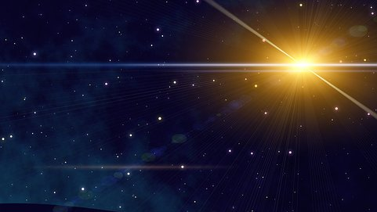
The people walking in darkness have seen a great light; on those living in the land of deep darkness
a light has dawned.
For to us a child is born, to us a son is given, and the government will be on his shoulders. And he will be called Wonderful Counselor,
Mighty God, Everlasting Father, Prince of Peace. Of the greatness of his government and peace there will be no end. He will reign on David’s throne and over his
kingdom, establishing and upholding it with justice and righteousness from that time on and forever. Isaiah 9:2,6,7

Slide 14
“… one who is more powerful than I will come,
the straps of whose sandals I am not worthy to untie … (Luke 3:16)
“A man who comes after me has surpassed me because he was before me … the reason I came baptising with water was that he might be revealed to Israel” (John 1:29,30)
”I am not the Messiah but am sent ahead of him …
He must become greater, I must become less” (John 3:28,30)

Slide 15
John prepared the way
for the One
who is the Way

Slide 16
Jesus said,
“I am the Way …
No-one comes to
the Father
except through Me.”
John 14:6

Slide 17
⁶ There was a man sent from God whose name was John.
⁷ He came as a witness to testify concerning [the] light,
so that through him all might believe.
⁸ He himself was not the light; he came only as a
witness to the light.
⁹ The true light that gives light to everyone was coming into the world.
¹⁰ ... the world was made through him...
¹¹ He came to that which was his own,
but his own did not receive him.
¹² Yet to all who did receive him, to those who believed in his name, he gave the right to become children of God.
John chapter 1

Slide 18
John’s baptism was a baptism of repentance
(for the forgiveness of sins)
He told the people to believe in the one coming after him,
that is, in Jesus”
Acts 19:4

Slide 19
Salvation is found in
no-one else,
for there is no other name
under heaven
given to mankind
by which we must be saved.
Acts 4:12

Slide 20
… the Lamb of God
who takes away
the sin of the world.
John 1:29

Slide 21
¹⁴ Since the children have flesh and blood, he too shared in their humanity so that by his death he might break the power of him who holds the power of death—that is, the devil— ¹⁵ and free those who all their lives were held in slavery by their fear of death …¹⁷ For this reason he had to be made like them, fully human in every way, in order that he might become a merciful and faithful high priest in service to God, and that he might make atonement for the sins of the people.
Hebrews 2:14-17

Slide 22
Abram (Abraham) believed God and it was credited it to him as righteousness
Genesis 5:16.

Slide 23
The Lord had said to Abram,
… all peoples on earth will be blessed through you.”
^{Genesis 12:1-3}

Slide 24
²³ The words “it was credited to him” were written not for him alone, ²⁴ but also for us, to whom God will credit righteousness—for us who believe in him who raised Jesus our Lord from the dead. ²⁵ He was delivered over to death for our sins and was raised to life for our justification.
¹Therefore, since we have been justified through faith, we have peace with God through our Lord Jesus Christ, ² through whom we have gained access by faith into this grace in which we now stand.
Romans 4:23-5:2

Slide 25
“Praise be to God, he has come and redeemed us.
He has raised up,
our Mighty Savior, Jesus
to rescue us from sin, death and Satan,
to enable us to worship and serve him without fear in holiness and righteousness
before him all our days,
This is all because of the tender mercy
of our God, by which the Lord Jesus, the Light of the world, has come to us from heaven. He has shone on us who were
living in darkness and in the shadow of death, & guided our feet into the path of peace.”

Slide 26
^{- Do I know Jesus?}
- Do I need to come back to Jesus?
- Am I experiencing God’s peace in my life?
- Am I preparing for Christmas in a way that reflects
^{my relationship with Jesus?}
^{- Am I living in light of}
^{Jesus’ second coming?}

Slide 27
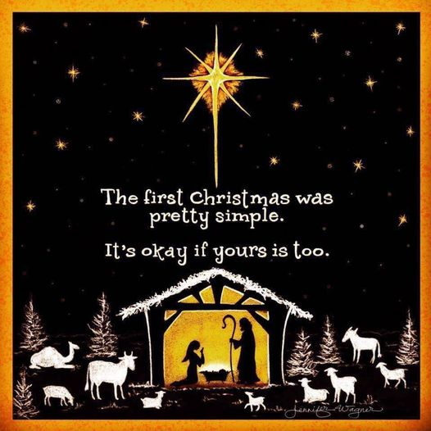

Slide 28
Christmas is not as much about opening our presents as opening our hearts
to Jesus.

